Slide 1
Amazon Digital Music Analysis
FIT5147 : Data Viz | Final Project Presentation | Vinh Phan

Slide 2


Menu
The ideas sheet
Alternative Designs
Cloud Words
Scatter Plot
Network Graph
Realisation
Appendix
Ref [1] https://www.123rf.com

Slide 3
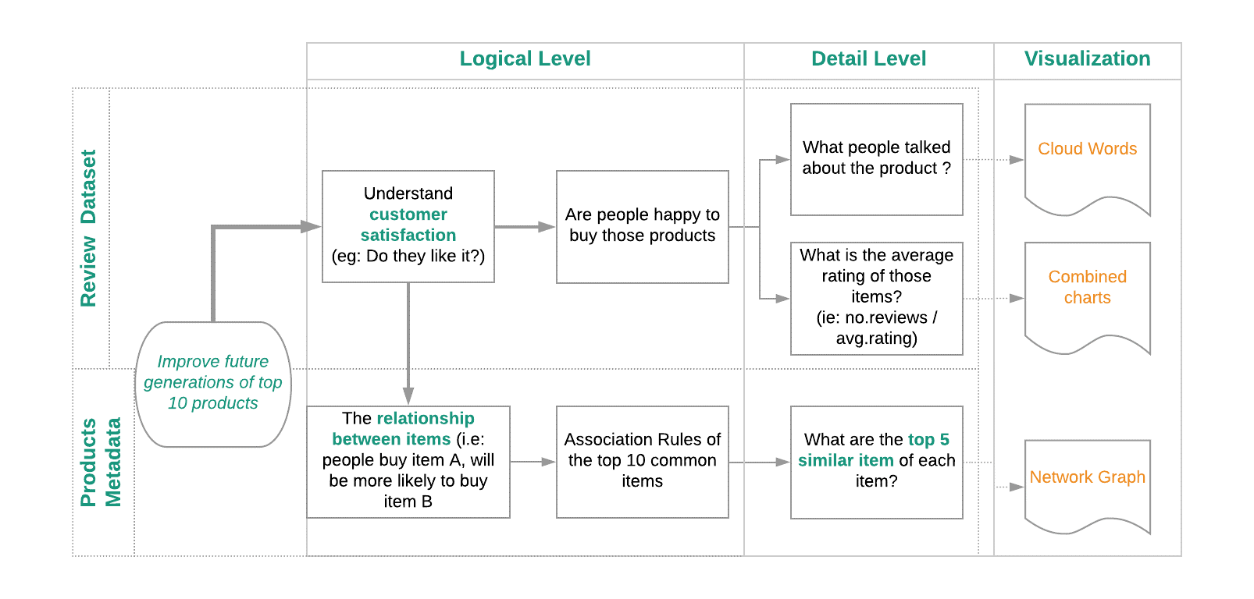
The ideas sheet

Slide 4
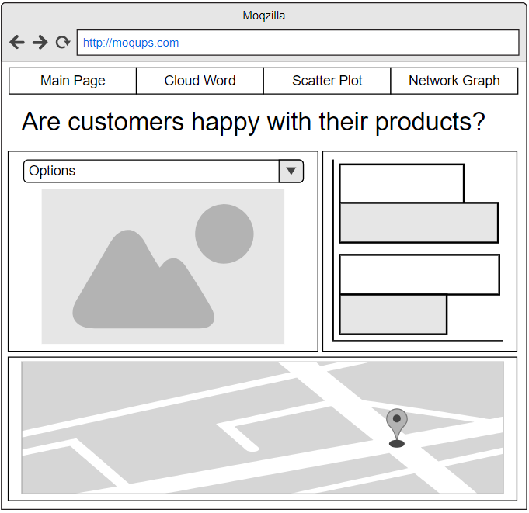
Word Cloud Design: Layout
Top common words
Horizontal Bar Chart
Reviews Distribution Map

Slide 5
Word Cloud Design: Focus / Zoom
Dropdown box to navigate products
Choropleth map for reviews distribution
Sidebar shows top 20 common words

Slide 6
Word Cloud Design: Operation
Hover words to see the its frequency
Clicking on the word, highlight the bars
Change products with combo box

Slide 7
Word Cloud Design: Discussion
Advantages | Disadvantages
Attractive design with colours, size | Less interactions from end users
Good technique to visualize text | Requires significant wrangling data
Quickly pick up the idea from the text

Slide 8
Appendix
Demonstration

